Slide 1


Module 5.3.1: Lists
ALL RIGHTS RESERVED © COPYRIGHT 2022
DO NOT DISTRIBUTE WITHOUT WRITTEN PERMISSION

Slide 2
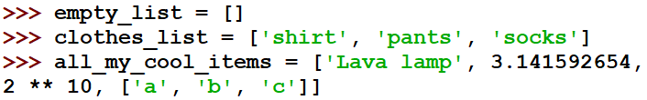
Lists
A list is a series of objects or items.
Lists are defined using square brackets – [].
They can hold any object in them – even another list!

Slide 3
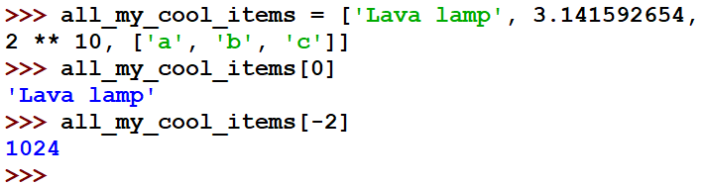
Indexing – Accessing a Single Item from a List
Indexing in lists acts just like in strings – using square brackets and beginning with an index of 0.

Slide 4
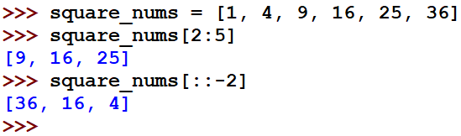
Slicing – Accessing a Sub-List of a List
This, again, is like slicing strings. While string slicing returns a string, accessing a slice of a list returns a list.

Slide 5
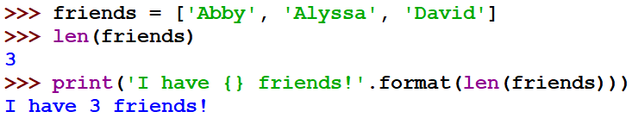
How long is a list?
How can we count the number of items in a list?
Use the len() function!
len() tells us the number of elements of any sequence (strings, lists, and more!)

Slide 6
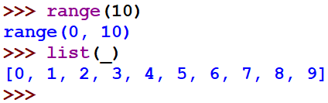
Casting
In earlier lessons, we turned strings into integers, integers into strings, Etc.
We can do the same with lists, using the list() operator!
We did this with a range object, in order to see all elements in the range:

Slide 7
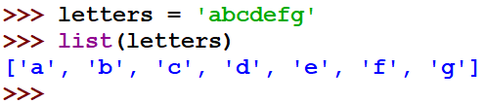
Casting - Strings
We can do the same with any object we can iterate over.
If we can treat that object as a sequence, we can turn it into a list!

Slide 8
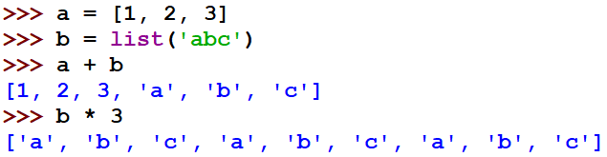
Using Arithmetic Operators
Like strings, we can concatenate or multiply lists, by using ‘+’ and ‘*,’ respectively. This does not change the original list but creates a new list.

Slide 9
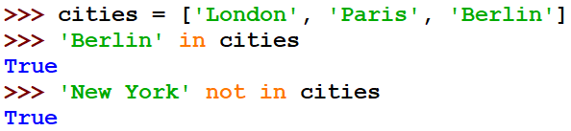
Using the ‘in’ Operator
Again like strings, using in or not in with lists checks if an object is one of the items in a list.

Slide 10
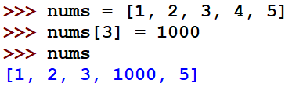
Replacing Values
In contrast to strings, individuals can easily replace values in a list, without creating a new one.

Slide 11
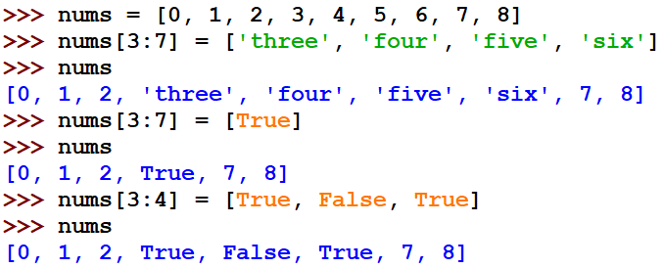
Replacing a Slice
We can do this using a slice as well. The replacing slice does not even need to be the same length!

Slide 12

List Methods
There are not many list methods, but every one of them is very useful!

Slide 13
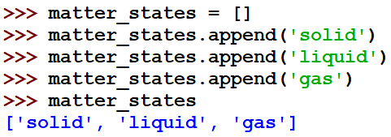
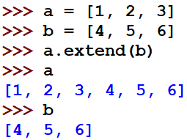
Append and Extend
The append method adds a new item to a list:
The extend method adds another list to the end of a list:

Slide 14
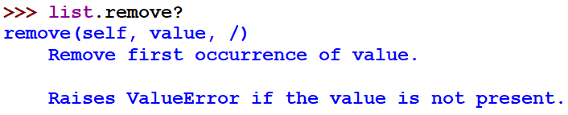
Learning New Methods
How can you teach yourself how to use a method you do not know?
Either use a question mark - ? – or the help() function!

Slide 15
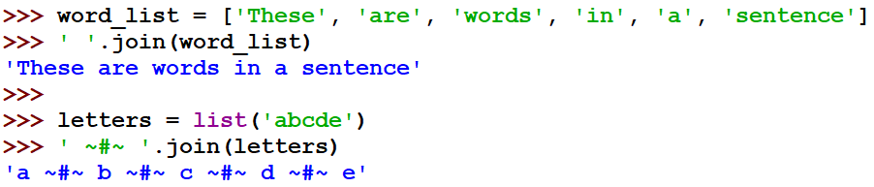
Join
There are two string methods we can learn now that we understand lists.
The join method (activated on a string) receives a list and returns a string. The new string is a concatenation of all items in the list, using the original string as a delimiter.
Of course, all items in the list must be strings.

Slide 16

Split
The split string method does the exact opposite – it divides a string into a list using a given delimiter.
When no delimiter is given to split, any number of whitespaces are used as delimiters.

Slide 17
Behind the Scenes of Lists
When assigning the value of 5 to a variable num, what Python does is saves the number 5 (somewhere in the computer’s memory), and gives us a pointer named num, that points to that value.
num
5

Slide 18
Behind the Scenes of Lists – cont.
With lists, the same happens.
Once a list is defined, the list items are saved in the computer’s memory, and a pointer named original is created, pointing to the data.
original
‘a’
‘b’
‘c’
‘d’

Slide 19
Behind the Scenes of Lists – cont.
What happens when we execute the following command?
A new pointer is created (not a new list!) that points to the same list.
original
‘a’
‘b’
‘c’
‘d’
new

Slide 20
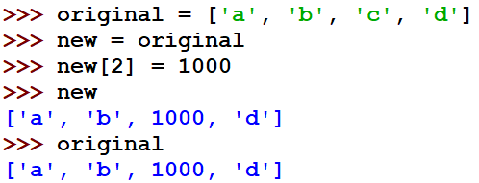
Two Pointers to the Same List
This can create many, many problems.
For this not to happen, we must copy the list, and not only the pointer. In other words, we must find a way to create a new list, exactly like the old one.

Slide 21
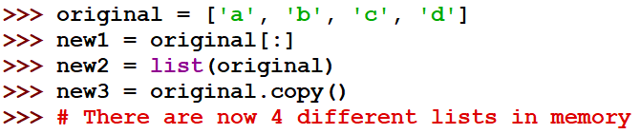
3 Ways to Copy a List
Using slicing – [:] – without a lower or an upper boundary.
Using the list() operator.
Using the .copy() method.

Slide 22
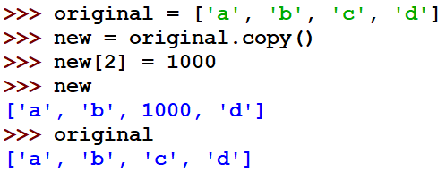
Behind the Scenes of Lists - Solution
This makes sure the original list is not modified.

Slide 23
List Summary
The List Type
Indexing and Slicing
Modifying Lists
List Methods
The “join” and “split” Methods
List Pointers and List Copying

